Slide 1
Final Engagement
Attack, Defense & Analysis of a Vulnerable Network
By: Graham Mortimore, Jay Ahir, Korbin Brower, Tom Cunningham

Slide 2
Table of Contents
This document contains the following resources:
Network Topology & Critical Vulnerabilities
Alerts Implemented
Hardening
Implementing Patches

Slide 3

Network Topology
& Critical Vulnerabilities
‹#›

Slide 4
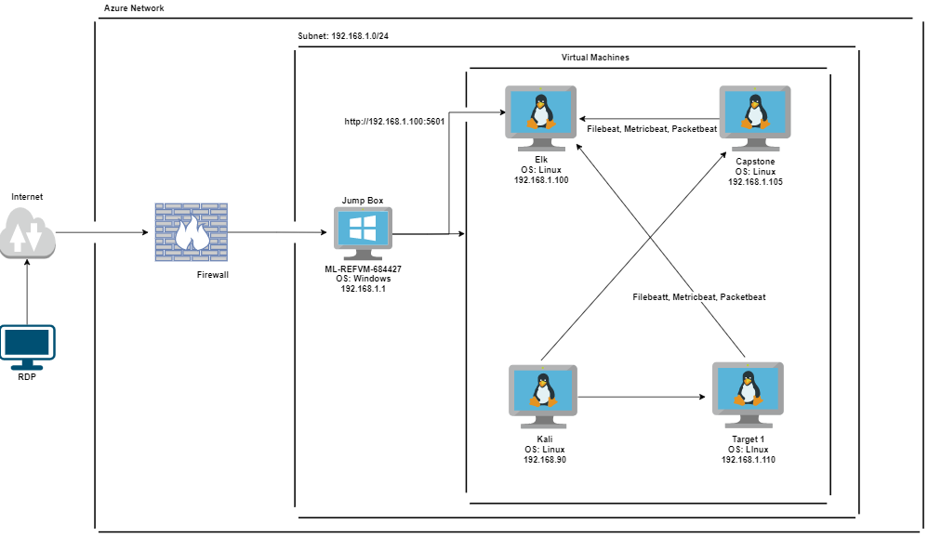
Network Topology
Network
Address Range: 192.168.1.0/24
Netmask: 255.255.255.0
Gateway: 192.168.1.1
Machines
IPv4: 192.168.1.1
OS: Windows
Hostname: ML-REFVM-684427
IPv4: 192.168.1.90
OS: Linux
Hostname: Kali
IPv4: 192.168.1.100
OS: Linux
Hostname: ELK
IPv4: 192.168.1.105
OS: Linux
Hostname: Capstone
IPv4: 192.168.1.110
OS: Linux
Hostname: Target1

Slide 5
Critical Vulnerabilities: Target 1
Our assessment uncovered the following critical vulnerabilities in Target 1.
Vulnerability | Description | Impact
Open Port 22 SSH | Port 22 is exposed | Easy access to target machine using SSH from an external source
Privilege Escalation | Easy escalation of user privileges to root access | Attacker able to gain full admin control over a system
WordPress | Outdated version of WordPress with many vulnerabilities | Able to enumerate the users of the WordPress server to gain access

Slide 6
Alerts Implemented
‹#›

Slide 7
HTTP Request Size Monitor
Summarize the following:
Which metric does this alert monitor?
This alert monitors all of the metricbeat data specifically watching the http.request.bytes field.
What is the threshold it fires at?
This alert fires when the sum of the total http request bytes exceeds 3500 within a minute timeframe.

Slide 8
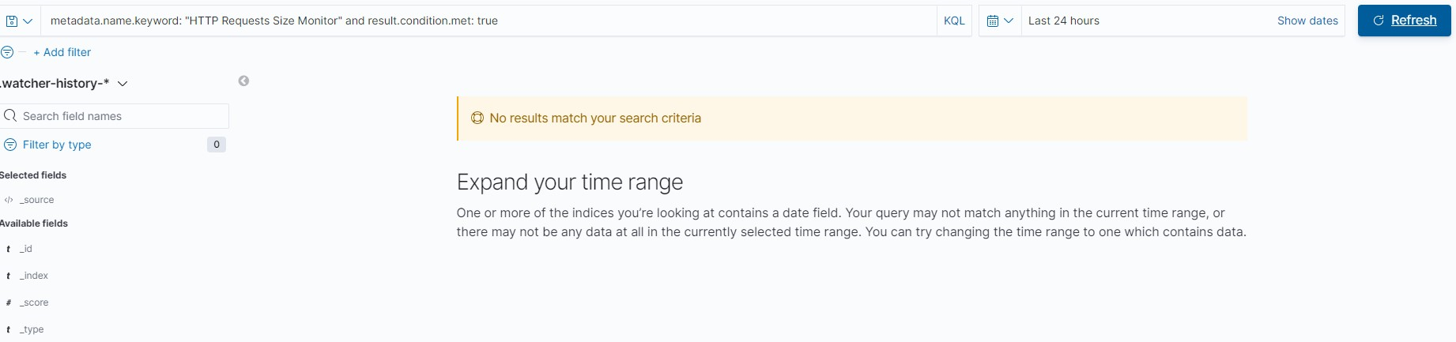
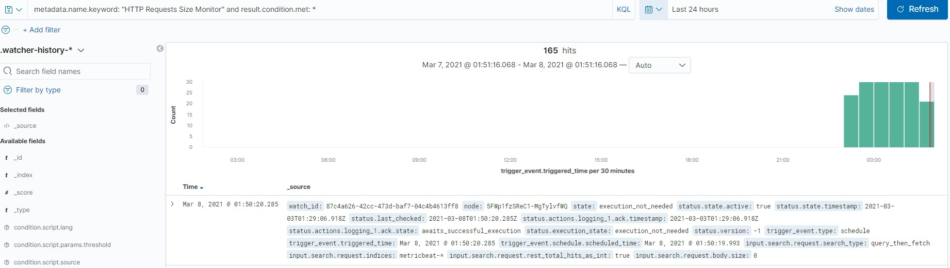
HTTP Request Size Monitor

Slide 9
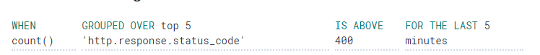
Excessive HTTP Errors
Summarize the following:
Which metric does this alert monitor?
This alert monitors all of the packetbeat data specifically the http.response.status_code field.
What is the threshold it fires at?
This alert fires when an HTTP response above 400 is detected within a 5 minute period.

Slide 10
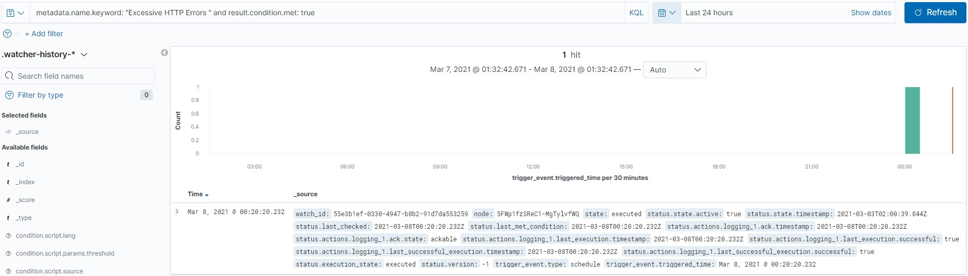
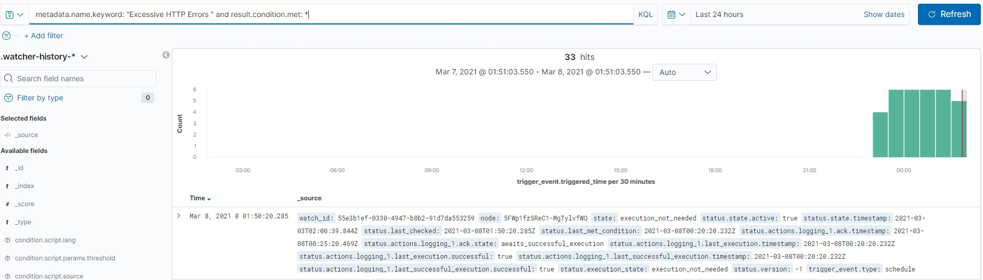
Excessive HTTP Errors

Slide 11
CPU Usage Monitor
Summarize the following:
Which metric does this alert monitor?
This alert monitors all of the metricbeat data specifically watching the system.process.cpu.total.pct field.
What is the threshold it fires at?
This alert fires when the total CPU usage of a machine exceeds 50% for the last 5 minutes.

Slide 12
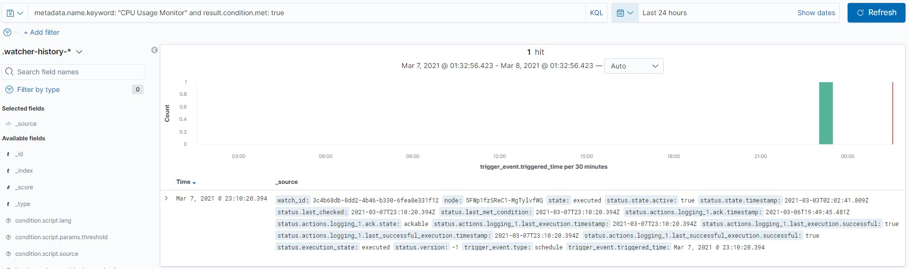
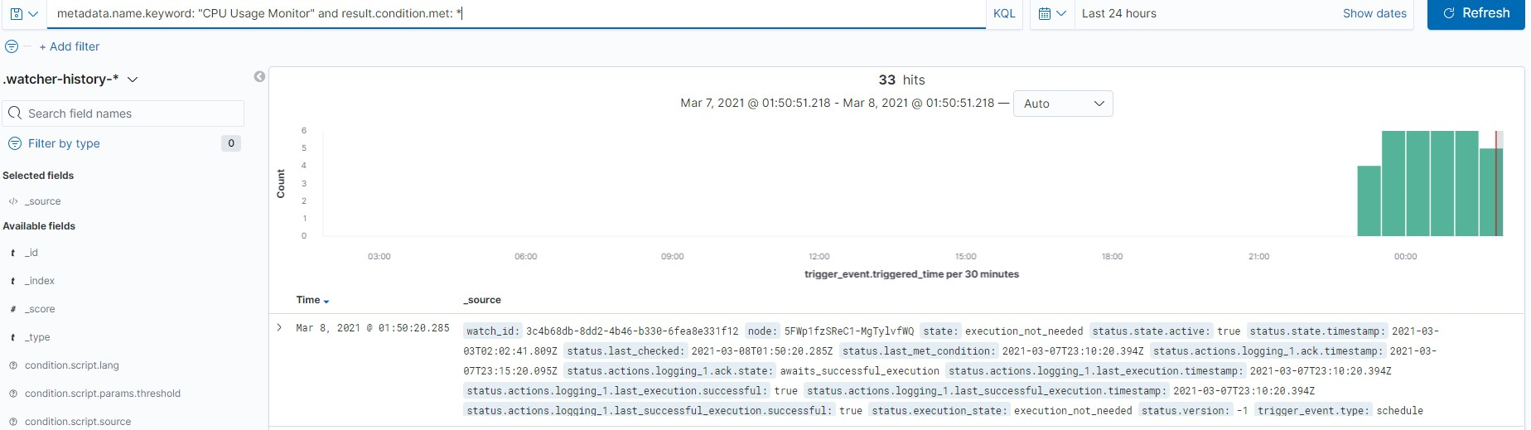
CPU Usage Monitor

Slide 13
Hardening
‹#›

Slide 14
Hardening Against Open Port 22 SSH on Target 1
Closing port 22 will not allow anyone to access the machine from SSH
In firewall settings there are options that allow for enabling or disabling any port
Having a written company policy which only allows SSH access from on-site would also mitigate the risk of an unauthorized user gaining remote access

Slide 15
Hardening Against Privilege Escalation on Target 1
Re-evaluate which users need which permissions, use least-privilege method to determine this (i.e. the salesperson may only need email access)
Clear out employees who no longer work for the company in the database
Audit the user accounts every quarter and adjust as necessary

Slide 16
Hardening Against WordPress Vulnerabilities on Target 1
Patch/update WordPress to the most recent patch available
Updates and patches are typically found on the company webpage for the product. If the company has a paid-for account then these updates are easily and readily available to download
Having an ansible playbook which gets and installs updates automatically would be the most efficient method for staying current with them

Slide 17
Implementing Patches and Changes
‹#›

Slide 18
Implementing Patches with Ansible
Playbook Overview
Running this playbook will update WordPress with the latest security features
It is setup to do the full update process automatically to ensure WordPress can always stay up to date

Slide 19
Implementing Patches with Ansible
---
-name: Download and unpack latest WordPress
hosts: https://wordpress.org/latest.tar.gz
dest: "/var/www/192.168.1.110/wordpress"
remote_src: yes
creates: "/var/www/192.168.1.110/wordpress"
-name: Set ownership
path: "/var/www/192.168.1.110/wordpress"
state: directory
recurse: yes
owner: root
group: root
-name: Update Wordpress config file
apt:
update_cache: yes
force_apt_update: yes
name: WordPress
state: present
-name: Restart httpd service
systemd: name=http state=restarted
become: yes
Downloads latest version of wordpress, unzips and installs the application to the machine.
Determines the owner of the application and the directory which it will be installed.
Checks for any updates to WordPress and patches the application accordingly.
Restarts the application so the updates will take effect.

Slide 20
Making Changes to Firewall Rules
Run the following commands:
firewall-cmd --permanent --remove-port=22/ssh
firewall-cmd --permanent --remove-service=ssh

Slide 21
Making Changes to User Privileges
Make the following changes:
Remove execute privileges from all users
This prevents root escalation using python

